Slide 1
Final Project
MATH-2200
Professor: Ying Wang
Student: Son Nguyen

Slide 2
Research Question
Research Question 1: What customer characteristics are associated with the likelihood of applying a discount?
Research Question 2: What factors influence the frequency of items purchased by a customer?

Slide 3
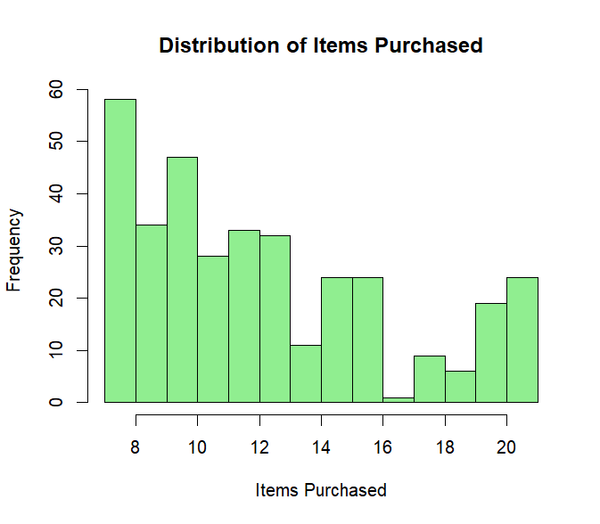
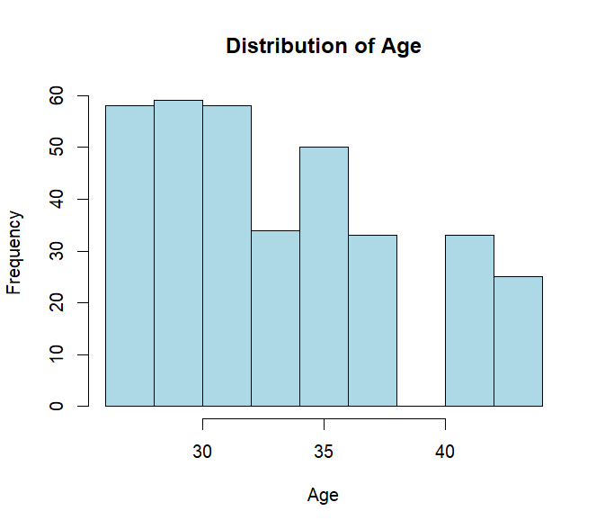
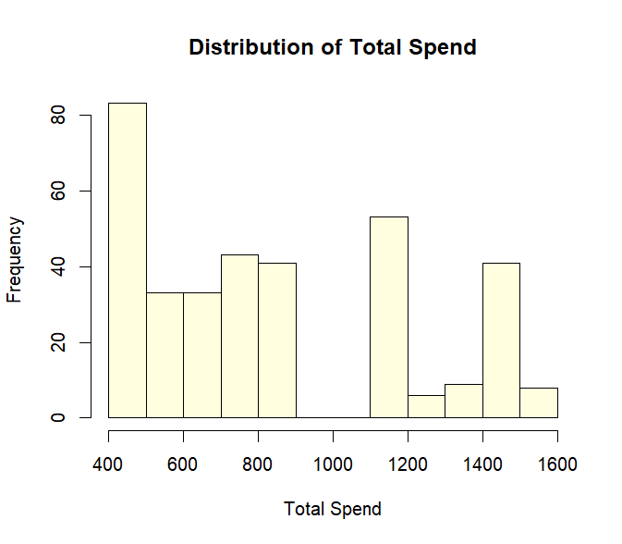
Distribution

Slide 4
What Predicts Discount Application?
Predictor | Odds Ratio | P-value | Significant
Age | 0.065 | 0.052 | No
Total Spend | 1.04 | 0.096 | No
Item Purchased | 1.859 | 0.664 | No
Days Since Last Purchased | 49.21 | 0.019 | Yes
Only Days Since Last Purchase was statistically significant (p = 0.019)
OR = 49.21 — customers inactive longer are far more likely to apply a discount
Age, Total Spend, and Items Purchased showed no significant effect (p > 0.05)
→ Conclusion: discounts serve as a re-engagement tool for inactive customers

Slide 5
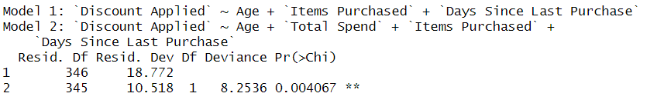
Likelihood Ratio Test for Total Spend
Adding Total Spend significantly improves model fit (p = 0.004)
Total Spend should be retained in the model despite p = 0.096

Slide 6
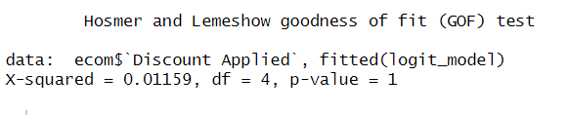
Hosmer-Lemeshow Goodness-of-Fit Test
Hosmer-Lemeshow test: p = 1.00 → model fits the data well.
Predicted probabilities closely match observed outcomes across all groups.

Slide 7
Somer’s D
Somer’s D | C statistic | n | Missing
0.998 | 0.9999 | 350.0 | 0.0
Somer's D = 0.9998 → near perfect discrimination ability
Model correctly ranks discount vs non-discount customers almost perfectly
C statistic = 0.9999 → excellent model performance (well above 0.7 threshold)

Slide 8
Confusion Matrix
 | Actual: 0 | Actual:1
Predicted: 0 | 173 | 1
Predicted: 1 | 2 | 174
Model correctly classified 347 out of 350 customers (99.1% accuracy).
Sensitivity = 99.4% — almost all discount users correctly identified .
Specificity = 98.9% — almost all non-discount users correctly identified .
Only 3 misclassifications out of 350 observations.

Slide 9
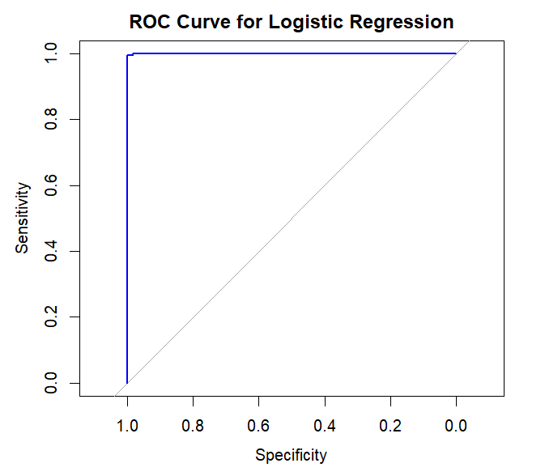
ROC and AUC
AUC = 0.9999 — near perfect model discrimination.
Model can almost perfectly distinguish between customers who apply a discount and those who don’t.
ROC curve hugs the top left corner, confirming exceptional predictive performance.

Slide 10
What Influences Purchase Frequency?
Total Spend and Days Since Last Purchase are significant (p < 0.05).
Age and Average Rating show no significant effect.
Customers who spend more and have been inactive longer tend to purchase more items.
Predictor | Rate Ratio | P-value | Significant
Age | 0.999492 | 0.92199 | No
Total Spend | 1.000752 | 8.75e-08 | Yes
Average Rating | 1.127896 | 0.18652 | No
Days Since Last Purchased | 1.004366 | 0.005 | Yes

Slide 11
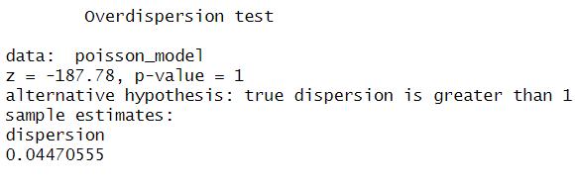
RS2: Overdispersion Test
Overdispersion test: p = 1.00, dispersion = 0.045
No overdispersion detected variance is actually less than the mean (underdispersion) .
Standard Poisson model is appropriate, no need for Quasi-Poisson adjustment.

Slide 12
Quasi Poisson
Predictor | P-value | Significant
Age | 0.646 | No
Total Spend | < 2e-16 | No
Average Rating | 1.53e-09 | No
Days Since Last Purchased | < 2e-16 | Yes
Total Spend, Average Rating, and Days Since Last Purchase are significant (p < 0.05)
Age has no significant effect on items purchased (p = 0.646).
Higher total spend, better ratings, and longer inactivity all predict more items purchased.

Slide 13
Multicollinearity
Age | Total Spend | Average Rating | Days Since Last Purchase
2.465462 | 12.370244 | 11.631543 | 1.958317
Age (2.47) and Days Since Last Purchase (1.96) show no multicollinearity concern. ( VIF < 5)
Total Spend (VIF = 12.37) and Average Rating (VIF = 11.63) both exceed the acceptable threshold of 10. This shows sign of multicollinearity

Slide 14
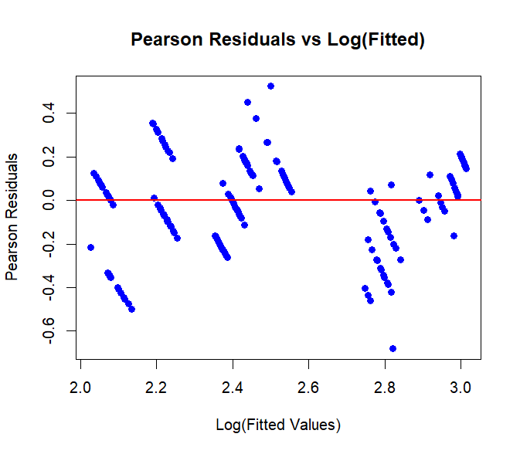
Residual plot
No specific pattern in residuals model assumptions are reasonably met.
Residuals centered around 0 across all fitted values.
Minor spread at some points but overall the model fits well.

Slide 15
Thank you for your attention!
Any question ?

